Slide 1
Jordan University of Science and Technology
General Overview

Slide 2
Outline
JUST Quick Facts
Human Resources
Academic Programs
Accreditation
JUST Library
Scientific Research
Res, Services & Consultative Centers
Strategic Projects in Progress

Slide 3
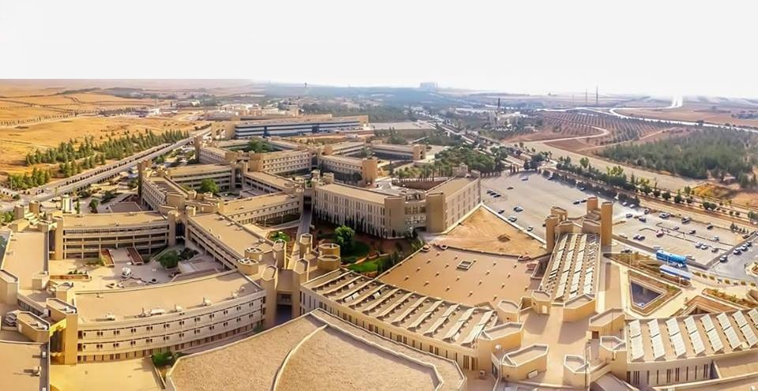
JUST
Quick Facts
JUST was established by a Royal Decree in the year 1986.
located on the outskirts of Irbid, in northern Jordan, 70 km north Amman, the capital city of Jordan.
A spacious campus spanning eleven square kilometers.
Is one of the most advanced and professionally oriented universities in the region.
JUST invested nearly 45 million JD (about 64 million dollars) in sponsoring scholars to pursue postgraduate studies at top universities in the world.

Slide 4
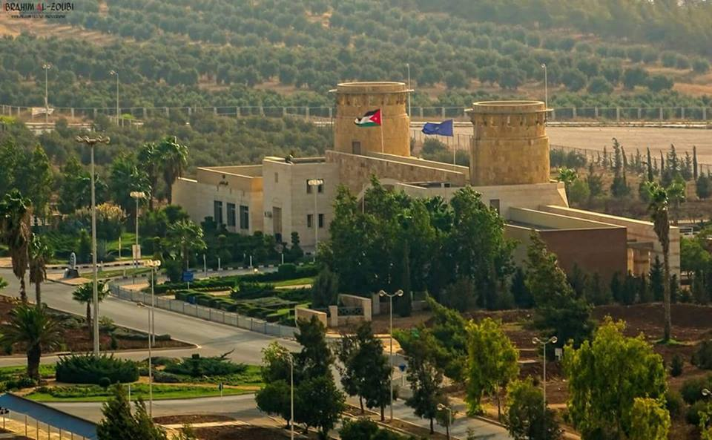
Quick Facts
JUST
JUST comprises 12 faculties 55 departments offering 42 undergraduate programs and 85 postgraduate programs.
Over 50,000 students have graduated to date.
Current enrollment:
22994 undergraduate students
2360 postgraduate students
4942 are non-Jordanians from 51 different nationalities.
20% International students representing the most diverse student body in the kingdom.

Slide 5
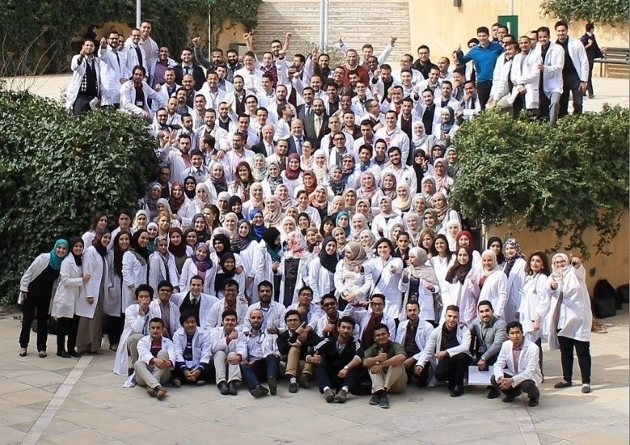
Faculty of Medicine
JUST
Vision:
The Faculty of Medicine at Jordan University of Science and Technology (FMJUST) is committed to teaching with creativity, and dedication; healing with quality, and compassion; and research with innovation.
Mission:
FMJUST is a community of scholars dedicated to provide relevant education to a diverse body of medical undergraduate and postgraduate students; to deliver state-of-the-art health care service and medical research.

Slide 6
JUST
Objectives:
To train students to be competent and skillful physicians to provide community-based health care.
To train medical students to be socially responsible with commitment to highest levels of professionalism and medical ethics.
To encourage students to practice life-long learning and continuous professional development and to explore post graduate opportunities.
To enable students to perform appropriate search and appraisal of medical literature.
To train students to apply latest appropriate health programs and technologies to provide patient-centered health services.
To lead preventive and management health programs and initiatives in North Jordan.
To lead health research projects in basic and clinical sciences that meet the needs of local and regional communities.

Slide 7
JUST
Faculty Members per Department, Total of (195)

Slide 8
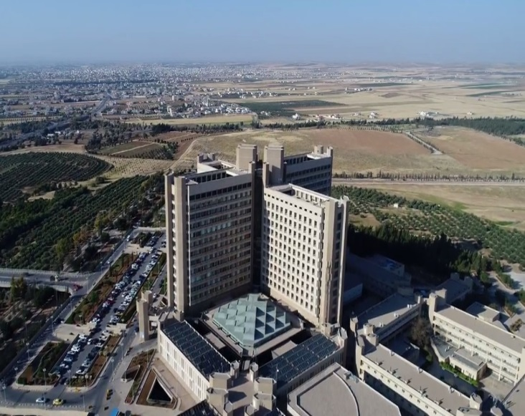
King Abdullah University Hospital
JUST
Introduction and Achievements
King Abdullah University Hospital was inaugurated by his Majesty King Abdullah II on 28 November 2002, has become one of the most prominent and reputable hospitals in Jordan and the region. It was established to address the critical lack of central, advanced medical facilities serving the population of Northern Jordan.
King Abdullah University Hospital, often-abbreviated KAUH, is the largest medical structure in the north of Jordan, serving approximately two million inhabitants from the Irbid, Ajloun, Jerash, and Mafraq governorates. It is also the teaching hospital affiliated with Jordan University of Science and Technology (JUST). The hospital is staffed with full-time physicians and surgeons who are members in the Faculty of Medicine at JUST.

Slide 9
King Abdullah University Hospital
JUST
JUST medical, dentistry, and nursing students complete laboratories, practicals, internship, and residency at or in close conjunction with KAUH and its extensive facilities.
KAUH is providing state of the art medical care through distinguished medical and paramedical staff, equipped with up to date technology. For this, several centers of excellence have been established; such as: (Princess Muna El-Hussein Cardiac Center, Cochlear Implant Center, IVF Center, Urology Center and Spine Center).
To pursue our excellence in medical care, the plan is to transform KAUH into comprehensive medical city. The establishment of Radiotherapy Center is one of our top priorities in the near future, and the work is rapidly undergoing.
KAUH is planning to establish a network with other governmental hospitals in the northern region, to organize and coordinate the medical care in a cost-effective and efficient manner.

Slide 10
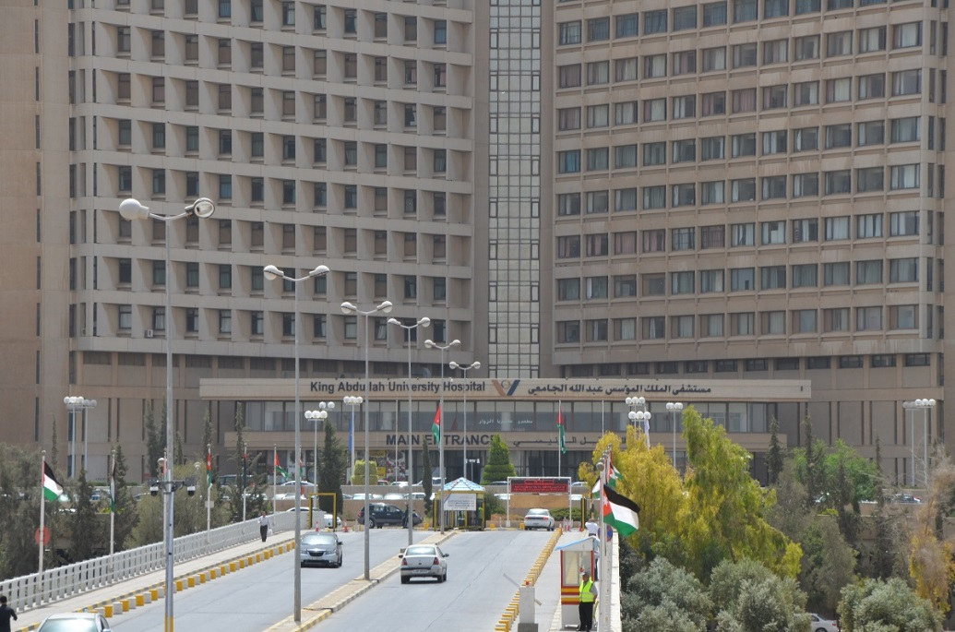
King Abdullah University Hospital
JUST
KAUH is committed to bringing state-of-the-art medical services to our country, while remaining true to our mission of caring for the people in our community, we serve based on three main issues:
1. Establish the concept of social responsibility to meet the needs of the local community.
2. Hold ongoing free medical days, and overall health awareness campaigns.
3. Increase the effectiveness of media communications and education to the community through the media platforms and social media networking.

Slide 11
King Abdullah University Hospital
JUST
Facts and Figures
1. KAUH is one of the distinct landmarks in Jordan and the region as a whole, based on its design and healthcare services provided.
2. KAUH provides various clinical and referral healthcare services to other healthcare sectors in Jordan
3. KAUH is a university hospital where all JUST health science students receive their education and training.
4. The overall area of various hospital buildings is (95583 m2), in addition to a double-story car park of (9000 m2). The hospital bed capacity is (651) beds, which can be increased to (700) beds in any emergent situation.
5. Structurally, the hospital is composed of a (15) story high-rise building, in which all hospital beds are located, and a 3 story Low-rise buildings in which out patients clinics, diagnostic and other services are located. The hospital is connected to various health science faculties via the ground floor of the low-rise building.
6. Technically, KAUH has been equipped with fixed and mobile equipment that are the top of their line.
7. Highly qualified and experienced Medical, technical and administrative personnel

Slide 12
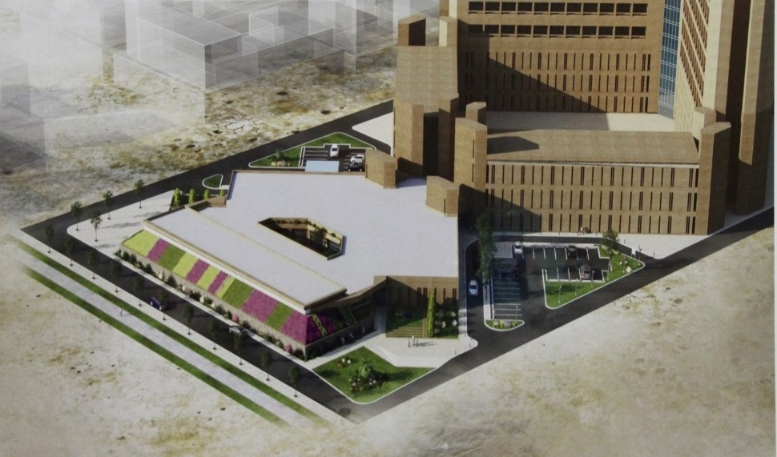
King Abdullah University Hospital
JUST
The Radio Therapy Center
The Radio - Therapy Center is the largest strategic project initiated by King Abdullah University Hospital (KAUH).
The project is funded by a Saudi grant through the Saudi Fund for Development with a value of $12 million as part of the Gulf grant.
It aims to provide cancer patients from the northern region with radiation treatment, which will make KAUH a major Centre for all medical and treatment cases, as well as consists of civil works that include the construction of the two floors - center with a total area of about 2000 square meters, including four radiotherapy rooms.

Slide 13
King Abdullah University Hospital
JUST
The Radio Therapy Center
The center will be equipped with medical equipment including the supply and installation of medical equipment, including equipment for treatment Radiological and other supporting medical devices, as well as advisory services.
The purpose of this project, which will take 540 days to implement, is to develop the hospital's treatment services of cancer patients, and open up new horizons in treatment services in line with the great development of the hospital, which considered the only hospital in the north region that provides health care in all medical fields.

Slide 14
JUST
The most Internationally Diverse Student Body in Jordan

Slide 15
Human Resources
JUST
Total Full-Time Faculty 962 (27.8% Females)
Administrative & Technical Staff
Faculty to Staff Ratio : 0.44 : 1

Slide 16
JUST
Distribution of Faculty Members Among University Faculties

Slide 17
JUST
Current Scholars Completing Postgraduate Studies Abroad

Slide 18
JUST
Faculty distribution According to Origin of Postgraduate Certificate

Slide 19
Academic Programs
JUST
MediTec comprises 12 Faculties:
Medicine
Engineering
Science & Arts
Pharmacy
Dentistry
Agriculture
Veterinary Medicine
Architecture & Design
Information Technology
Applied Medical Sciences
Nursing
Graduate Studies
In addition to two Deanships:
Deanship of Scientific Research
Deanship of Students’ Affairs
55 departments offering 42 undergraduate
programs and 85 postgraduate programs.
Unique programs:
Nuclear Engineering
Aeronautical Engineering
Veterinary Medicine
Paramedics

Slide 20
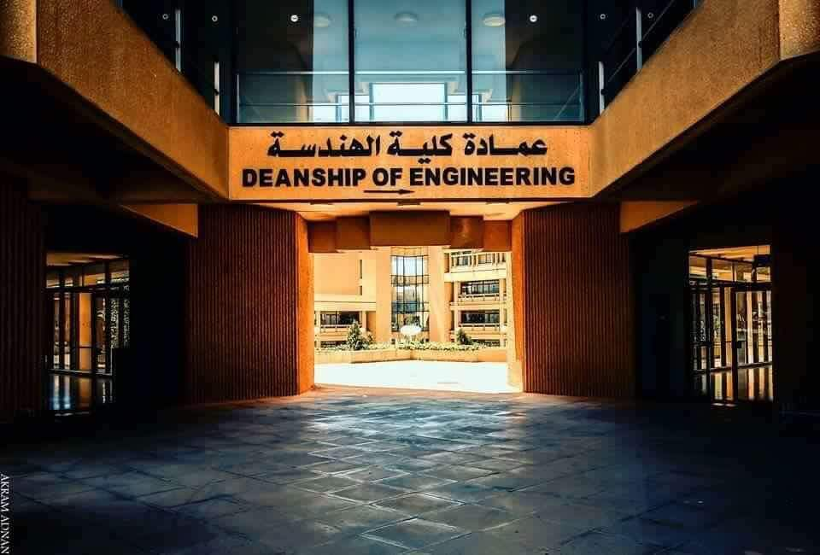
International Accreditation
JUST
Faculty of Engineering:
ABET
Chemical Engineering
Biomedical Engineering
Industrial Engineering
Electrical Engineering
Civil Engineering
Aeronautical Engineering

Slide 21
International Accreditation
JUST
Faculty of Dentistry
CODA
RCS (Ir)
MFD Exam Center (2004)
FFD Exam Center (2006)
The Lloyd's Register Quality Assurance (LRQA)
College of Architecture & Design:
NAAB (National Architectural Accrediting Board)
Health Center:
Health Care Accreditation Council (HCAC)
King Abdullah University Hospital (KAUH)
JCIA Accreditation, Joint Commission Interna
Faculty of Veterinary Medicine
European Association of Establishments for Veterinary Education –EAEVE.
Faculty of Medicine
WHO, World Directory of Medical Schools (Avicenna).
The AVICENNA Directory is maintained by the University of Copenhagen in collaboration with the World Health Organization and the World Federation for Medical Education (WFME).
Royal College of Pathology

Slide 22
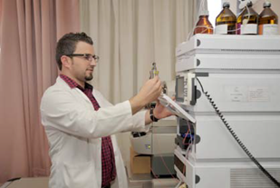
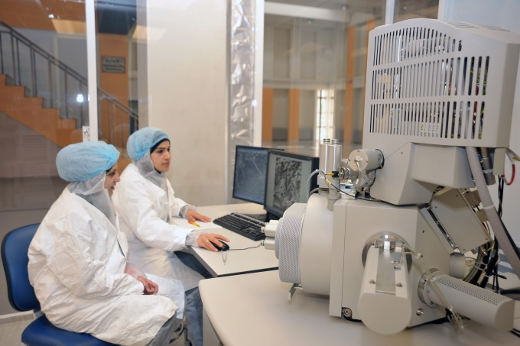
Scientific Research
JUST
Annually JUST spends around 7 million JD on Scientific Research (about 4.7% of total Budget)
4.7 Million JD R&D, Publications, Data base, Conferences, & incentives to researchers
1.5 Million JD on sabbaticals
Patents:
8 in process in the US
2 in process locally

Slide 23
Scientific Research Expenditure
JUST

Slide 24
Research Impact and Rankings
JUST

Slide 25
JUST
Times Higher Education Ranking Analytics

Slide 26
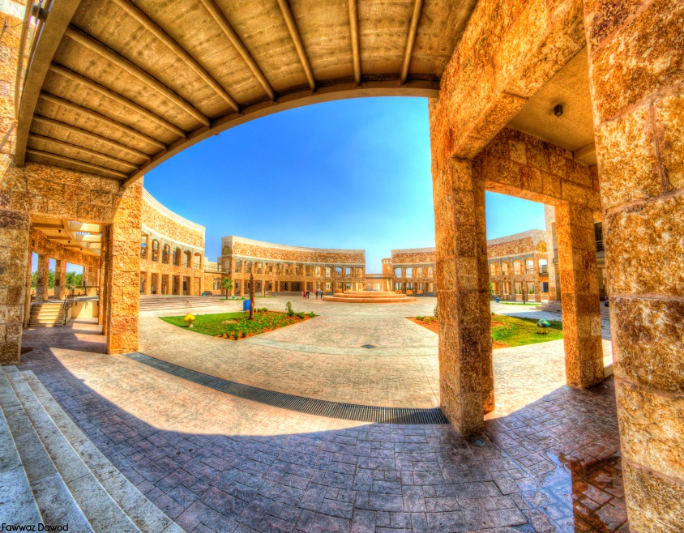
JUST Library
JUST
State of the art library to serve
students, faculty & researchers
Area: 12,500 M²
2500 visitors at the same time
Self service for circulation(check in and check out)
Providing access to:
180,000 printed materials
50 Electronic international database in different fields
56,000 Electronic Journals
309,000 Electronic Books
1.5 million theses around the world

Slide 27
JUST
Research, Services & Consultative Centers
Princess Haya Biotechnology Center
Pharmaceutical Research Center
Queen Rania Al-Abdullah Center for Environmental Science & Technology
Nanotechnology Center
Centre of Excellence for Innovative projects
Academic Development and Quality Assurance Center
Consultative Center for Science & Technology
Computer & Information Center
Health Center
Dental Teaching Center

Slide 28
Strategic Projects
JUST
Solar farm stage I: 5 Mw 4.4 Million JD
Solar farm stage II: 20 Mw 14 Million JD
Vet. Hospital: 4.6 Million JD
Medical Waste Incinerator: 1.0 Million JD
Presidency Building 3.3 Million JD

Slide 29
JUST
Thank You

